Slide 1
Slumdog Millionaire: June 5 Lecture Part 2
Religion & Politics
By Dr. Chowdhury

Slide 2
“Hardline Hindu nationalists campaign against Taj Mahal” by Michael Safi
Why do hardline Hindu nationalists argue that the Taj Mahal has no place in Indian history? What kind of evidence do they provide to bolster their claim? What do they claim the Taj Mahal was originally?
How do the counter sources refute the Hindu nationalist arguments?
What can you infer about the opinion of the “average” Indians about this controversy from the article?

Slide 3
Answers
Hindu Nationalists:
A sanitized version of Indian history
No room for plurality & diversity
Black vs. white or Muslim vs. Hindu
Respected historians:
Muslim rulers Indians too
Most were tolerant
Indian history is heterogeneous
‘”Average” Indians :
Economy priority

Slide 4
Babri Mosque vs. Ram Janam Bhumi Conflict
Mosque built by Emperor Babar, founder of Mughal dynasty in 1500s
Hardline Hindus claim site used to be birth place of Hindu God-King Rama or Ram
Attack & destroy Mosque in 1992
Want to build Ram temple in its place

Slide 5
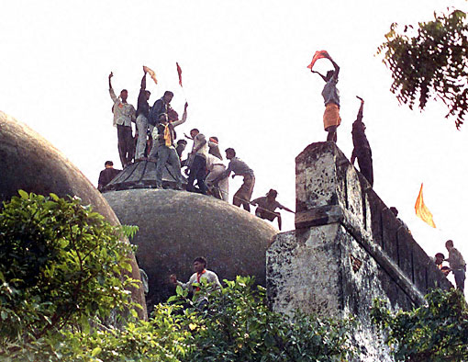
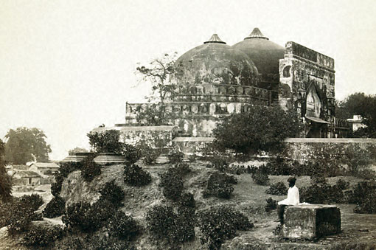
Babri Mosque
Hardline Hindus
Celebrate 1992
Before 1992

Slide 6
Babri Mosque Fallout
Ongoing law suit
Persistent hardliner attempt to build temple
Intermittent bloody attacks on Muslim minority
Reprisals by Muslim hardliners
More Muslims killed in revenge

Slide 7
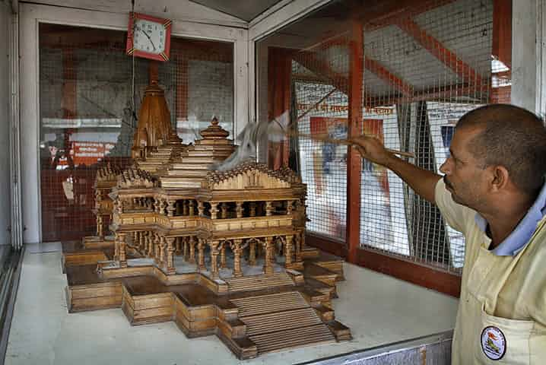
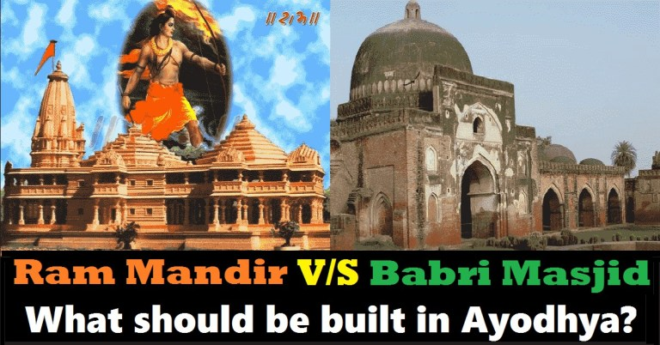
Temple or Mosque?

Slide 8
2002 Mass Killing of Muslims
Train returning from site of Babri mosque catches fire
Scores of Hindu pilgrims perish
Muslims blamed without proof
2000 killed including infants
Current Indian PM Modi was then provincial premier

Slide 9
Attack on Jamal-Salim’s slum
What details suggest that its is prompted by on going the Babri-Mosque conflict?
What is significant about the unidentified little boy Jamal and his brother briefly encounter as they try to flee from the blood thirsty mob?

Slide 10
Answers
Jamal to Prem: “If it weren't for Ram & Allah I would still have a mother”
Little boy costumed to look like Ram
Could be part of Hindu Nationalist propaganda
Looks startled and frightened, far from powerful God-figure
Children--Hindu & Muslim-- victims of adult politics

Slide 11
Ram in Hindu Belief System
Avatar or Vishnu—1 of 3 greatest Hindu Gods
Symbol of filial love, conjugal love, fraternal love
Ideal warrior
Ideal ruler
Life celebrated in Ramayana, ancient Indian epic

Slide 12
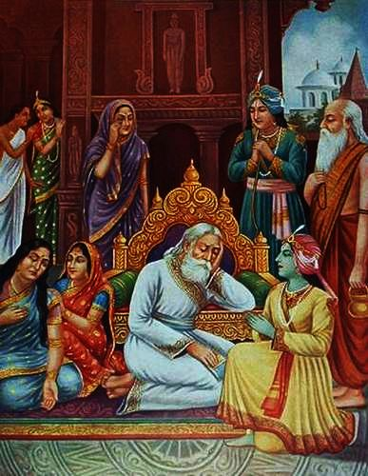
Ram Honors Father’s Rash Vow

Slide 13
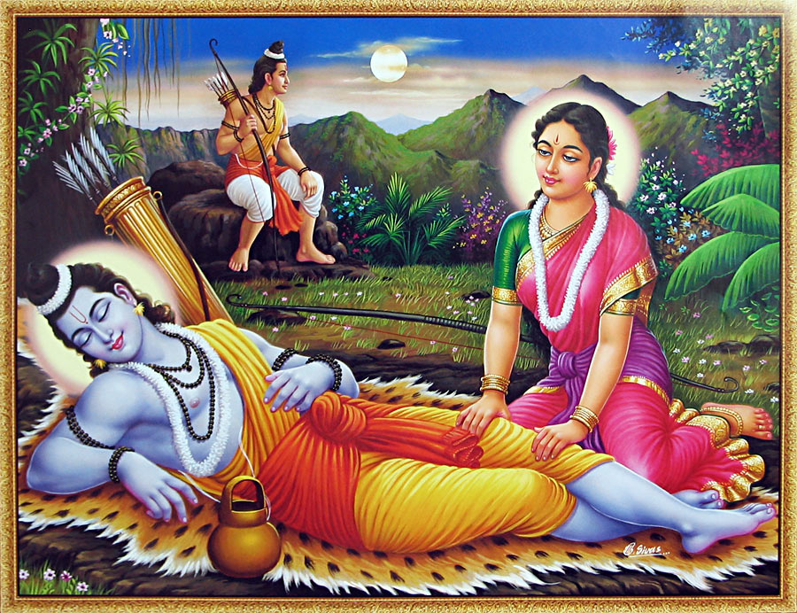
Hindu Holy Family in Forest Exile

Slide 14
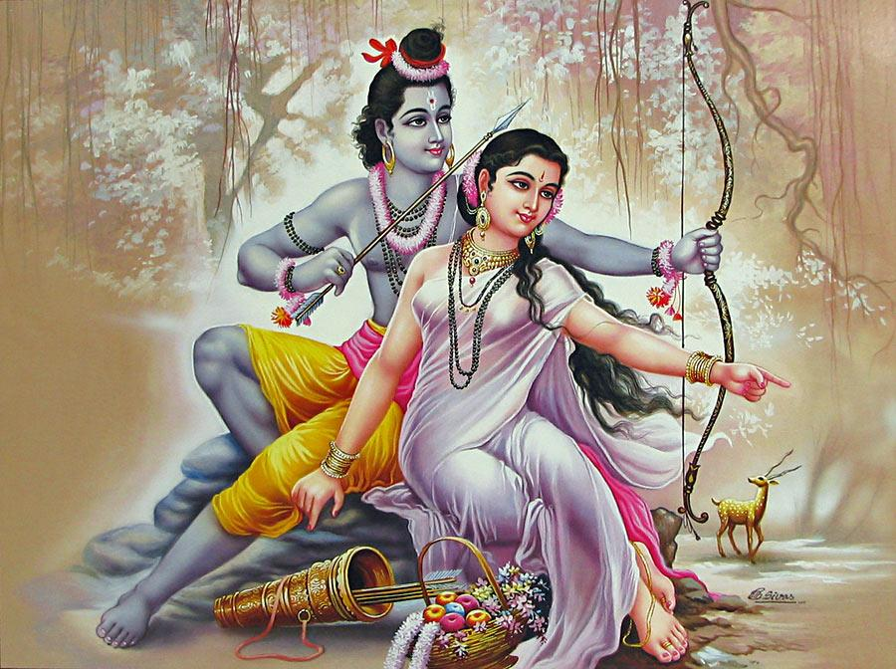
Doting husband

Slide 15
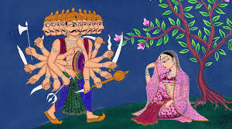
Demon King Abducts Sita

Slide 16
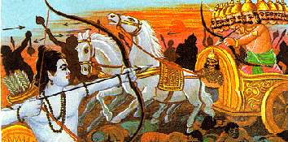
Ram Slays Demon-King

Slide 17
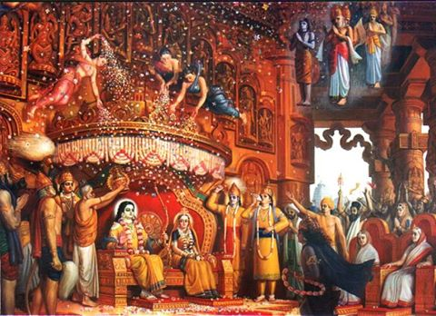
Coronation of Ram & Sita: Ram Rajya--Kingdom of Heaven on Earth--Utopia

Slide 18
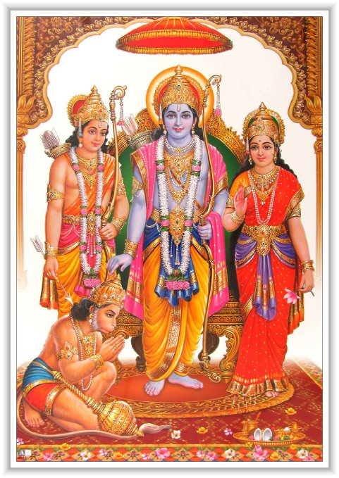
Hindu Holy Family Icon

Slide 19
Religion in Slumdog
Ram in film is
Pitiful
Absurd
Helpless
Impotent
Does not mock religion but a particular interpretation
Ram of Hindu Nationalists
Wants to create Hindu-Supremacist state
By excluding others

Slide 20
The “Slum” articles
Exactly what does the “slum tourism” being promoted currently in India involve? How does it compare with the “tour” that Jamal gives the American couple?
Why do some critics believe that this new version of slum tourism is still unethical? What do you think?

Slide 21
“Jamal-Salim Return Home” Scene
What connection did you notice between the main idea in “Absolute Hell” article and this scene?
How might the film be suggesting that there is some sort of a connection between the riot scene much earlier and this one?

Slide 22
Religion & Class Intersect
Real estate business+ right wing politicians+ organized crime= Unholy alliance
Real victims are urban poor regardless of religion or ethnicity

Slide 23
Interreligious Romance
Jamal (nominally Muslim)+ Latika (nominally Hindu)

